Slide 1
SYS_READY // GMIU_ASSIGNMENT
Social Engineering Attacks and Major Security Breaches
Understanding Cyber Threats, Attack Techniques and Prevention
STUDENT
ENROLLMENT NO.
SUBJECT
INSTITUTION
[Student Name]
[Enrollment Number]
[Subject Name]
GMIU

Slide 2


CONCEPT OVERVIEW
Hacking the Human Mind
Exploiting psychology over technical flaws.
Trust: Impersonating authority or colleagues.
Fear: Threatening account suspension or legal action.
Urgency: Demanding immediate wire transfers.
Curiosity: Baiting with hidden information.

Slide 3




ATTACK VECTORS
Types of Social Engineering
Phishing
Pretexting
Baiting
Fake emails and cloned websites.
Creating fabricated identities or stories.
Offering attractive items to trick victims.
Vishing
Smishing
Fraudulent high-pressure phone calls.
Deceptive SMS messages with malicious links.

Slide 4
THE LIFECYCLE
How the Attack Works
1
2
3
4
5
Fake Message
Delivery
Interaction
Data Stolen
Compromised
Attacker creates deceptive urgency.
Victim receives email or SMS.
Victim clicks malicious link.
Fake portal captures credentials.
Unauthorized network access achieved.

Slide 5
CASE STUDIES
Major Real-World Security Breaches
Twitter (2020)
Target (2013)
Uber (2022)
Incident: High-profile accounts hijacked.
Incident: 40M payment cards exposed.
Incident: Deep internal infrastructure breach.
Method: Phone spear-phishing employees.
Method: Phishing an external HVAC vendor.
Method: Social engineering via MFA fatigue.
Impact: Massive cryptocurrency scam.
Impact: Unrestricted lateral network movement.
Impact: Source code and Slack databases exposed.
Lesson: Strict internal access limits needed.
Lesson: Vendor risk management is critical.
Lesson: Upgrade and rate-limit MFA methods.

Slide 6
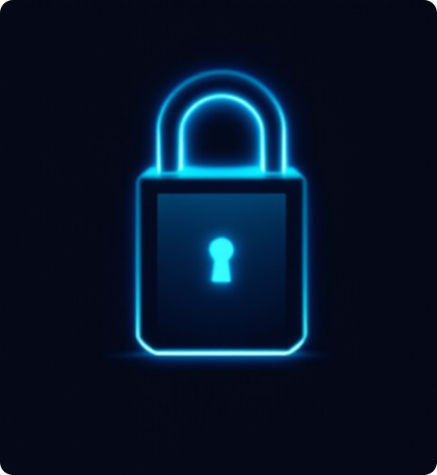
DEFENSE MATRIX
Prevention Strategies
Deploy strong, unique passwords.
Enforce Multi-Factor Authentication.
Never click unverified links.
Verify requests via secondary channels.
Ban usage of unknown USB devices.
Provide regular security training.

Slide 7


OPERATIONAL PROTOCOL
Do's and Don'ts
DO
DON'T
Verify sender identities before replying.
Never share OTPs or passwords.
Inspect URL domains for typos.
Avoid opening unknown attachments.
Report suspicious messages to IT.
Ignore unexpected prize notifications.
Protect personal operational data.
Do not connect found USB drives.

Slide 8

Stay Secure. Stay Vigilant.
Thank you for your time. Questions?

Slide 9

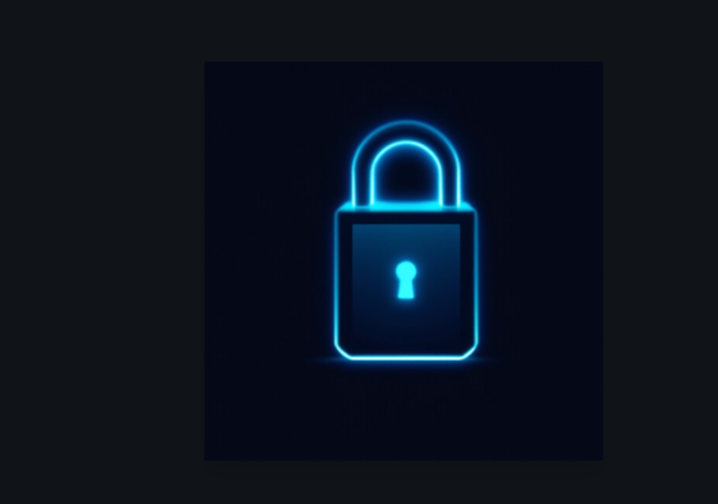
Image Sources
https://images.stockcake.com/public/2/3/a/23a3e61b-a196-4d72-9545-faee77d5d5e0_large/cyberpunk-security-icon-stockcake.jpg
Source: stockcake.com

